Slide 1
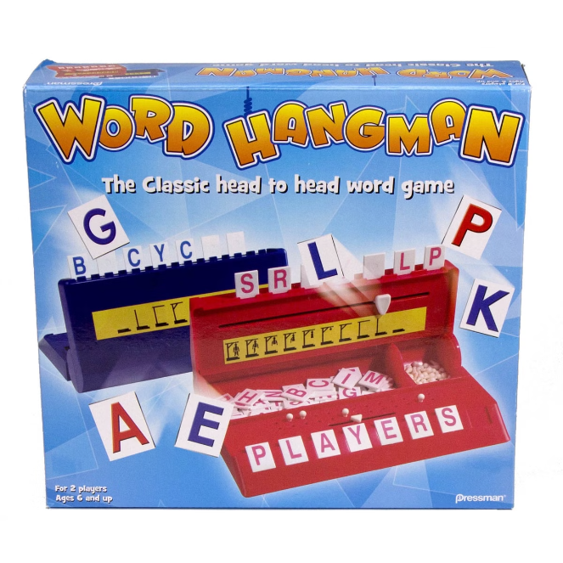


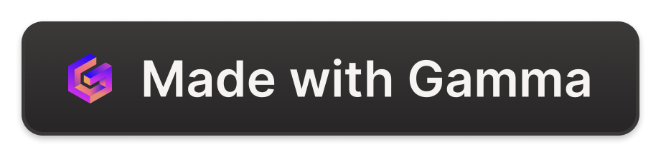
Hangman Game in Python
Hangman is a classic word-guessing game. The game involves guessing letters to reveal a hidden word. Players have a limited number of incorrect guesses, represented by the "hangman" figure.
Dimple Vardhi(192220081)
Sheryn Beulla.P(192219054)

Slide 2

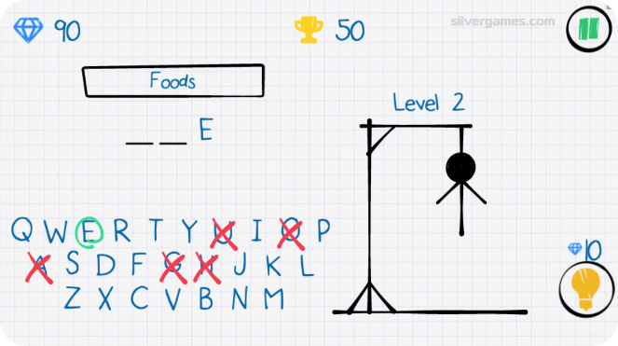
Objective of the Game
Guess the Word
The player's primary objective is to correctly guess the secret word before the hangman figure is fully drawn.
Avoid Incorrect Guesses
Each incorrect guess contributes to the completion of the hangman figure. Players need to minimize incorrect guesses to avoid "hanging" the man.

Slide 3

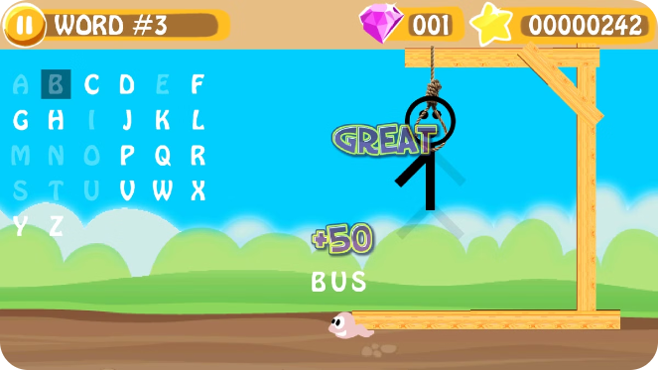
Introduction to Hangman Game
1
Word Selection
The game begins with a hidden word chosen from a predefined list or input by the user.
2
Blank Spaces
The hidden word is represented by a series of blank spaces, corresponding to the number of letters in the word.
3
Letter Guesses
Players make guesses by inputting letters they think are in the word.
4
Correct Guesses
If a guessed letter is correct, it is revealed in its corresponding position in the word.

Slide 4

Steps and Detailed Explanation
Initialization
1
The game sets up the hidden word, the hangman figure, and the number of incorrect guesses allowed.
2
Guessing Phase
Players input letters until they guess the word or run out of guesses.
Validation and Update
3
The game checks if the guessed letter is in the word, updating the display and the hangman figure accordingly.
4
Outcome Determination
The game determines the outcome, either victory by guessing the word or defeat by completing the hangman figure.

Slide 5
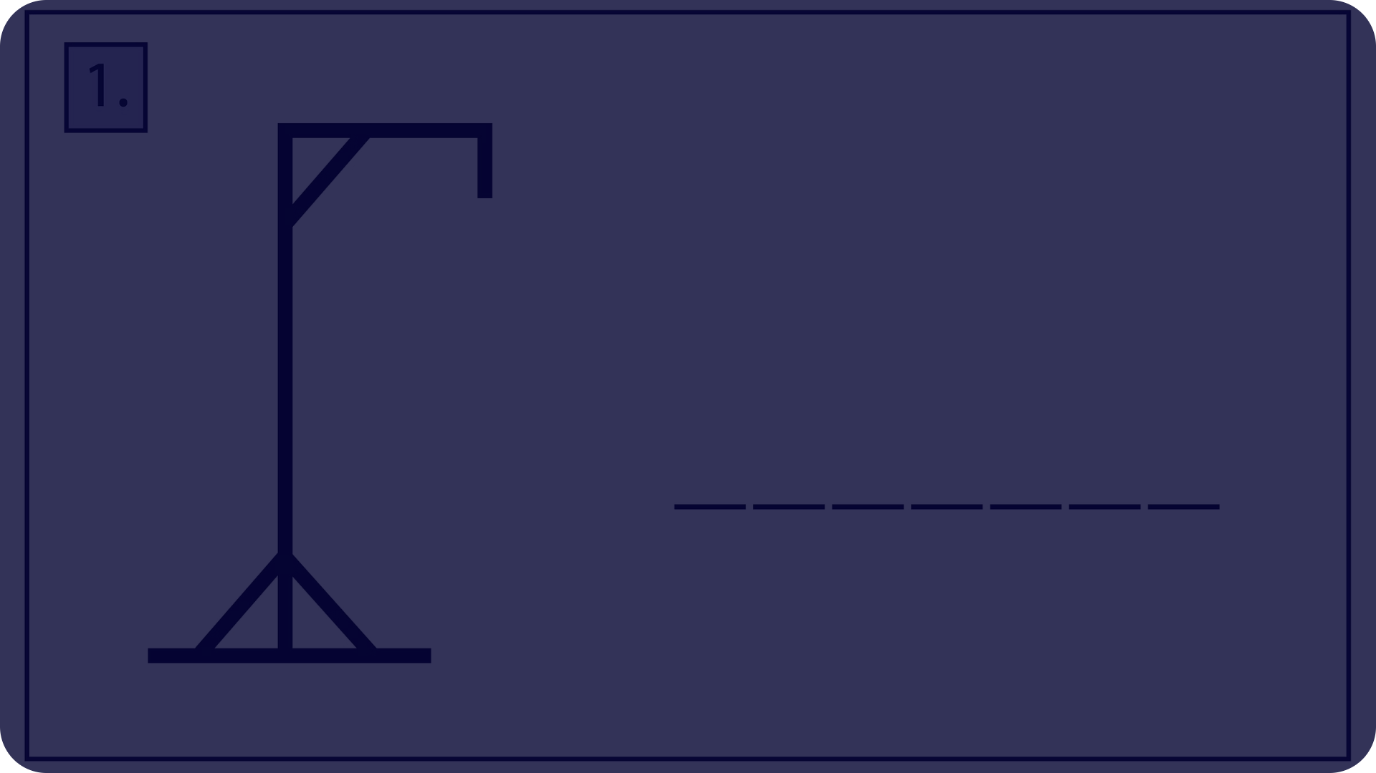




Displaying the Hangman Diagram
Initial State
Head
Body
Arms and Legs
The game starts with an empty hangman figure, consisting of a base and a stand.
After the first incorrect guess, the head of the hangman figure is drawn.
The second incorrect guess adds the body of the hangman figure.
Subsequent incorrect guesses complete the hangman figure with arms and legs, leading to a "hanging" outcome.

Slide 6
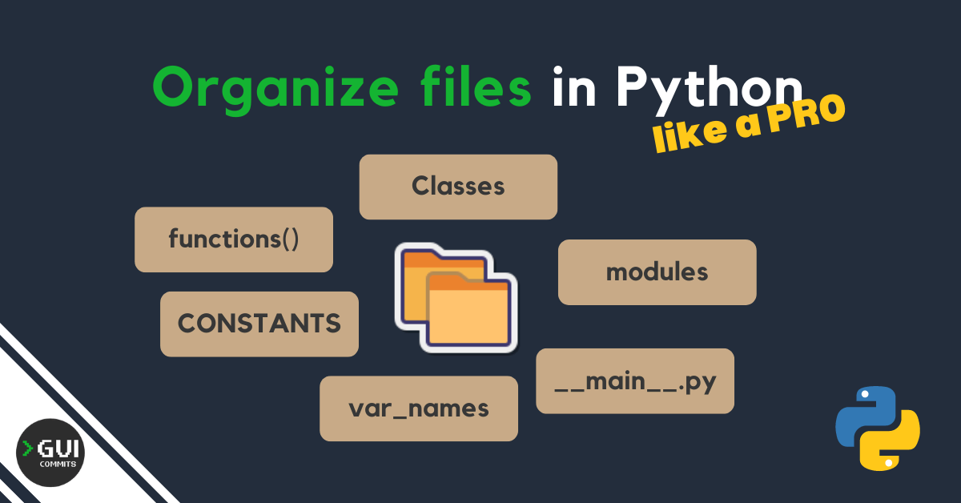
About the Algorithm
in the Game
Word Selection
The algorithm chooses a random word from a list or accepts user input.
Guess Handling
The algorithm checks if the guessed letter exists in the word and updates the display accordingly.
Outcome Determination
The algorithm monitors the number of incorrect guesses and determines the game's outcome based on the word being guessed or the hangman figure being completed.

Slide 7

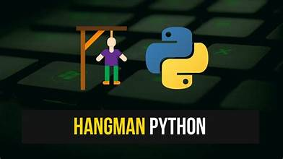
Small Logics of the Python Code in Hangman Game
Input Validation
Ensuring user input is a single letter.
Letter Checking
Determining if the guessed letter is in the hidden word.
Display Update
Revealing the letter in its correct position if it is in the word.
Hangman Figure Update
Drawing parts of the hangman figure for each incorrect guess.
Outcome Check
Determining whether the player has won or lost.

Slide 8
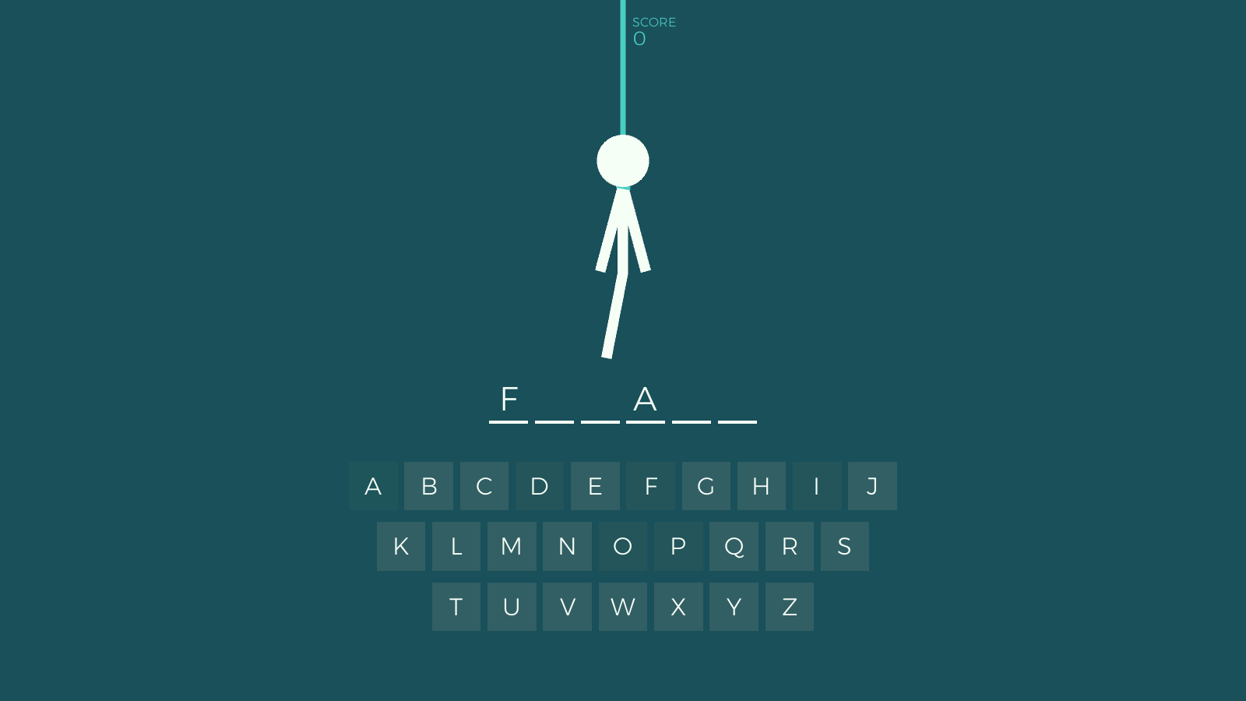




Pros and Cons
Engaging Gameplay
Limited Complexity
Educational Value
Potential Frustration
The simple rules and the element of suspense create a fun and addictive experience.
The core mechanics of the game are relatively straightforward, potentially limiting replay value.
Hangman can help improve vocabulary, spelling, and word recognition skills.
The limited number of incorrect guesses can lead to frustration, especially for difficult words.

Slide 9
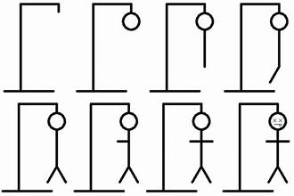
Methodology and Block Diagram
Word Initialization
1
The game begins by selecting a random word or accepting user input.
2
Guess Input
The player enters a letter as their guess.
Guess Validation
3
The program checks if the input is a valid single letter.
4
Letter Check
The program determines if the guessed letter is in the word.
Display Update
5
The game updates the display based on the correctness of the guess.
6
Hangman Update
The hangman figure is updated for each incorrect guess.
Outcome Check
7
The program checks if the player has won or lost.

Slide 10
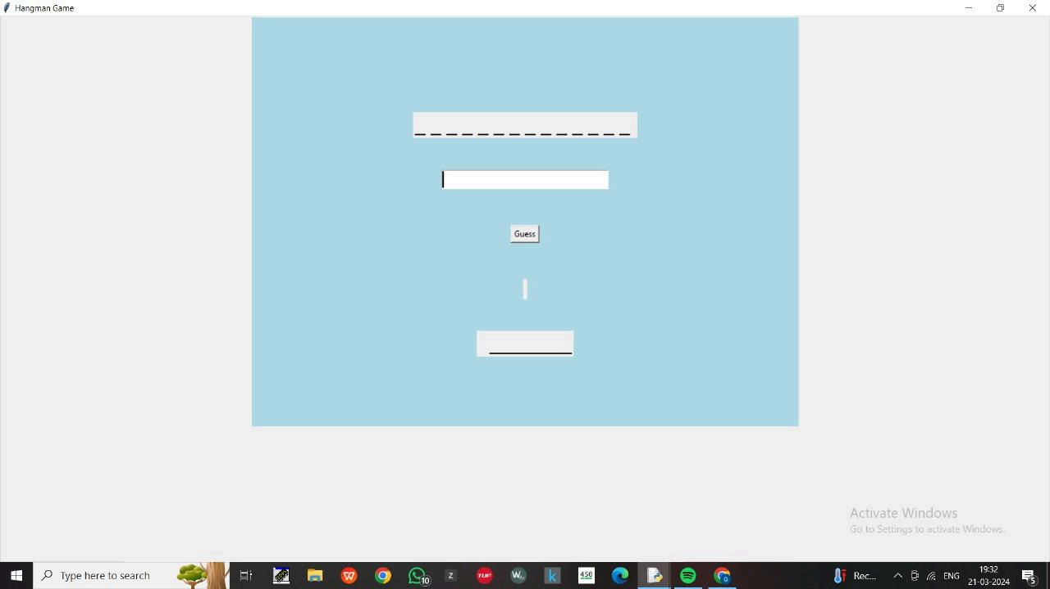
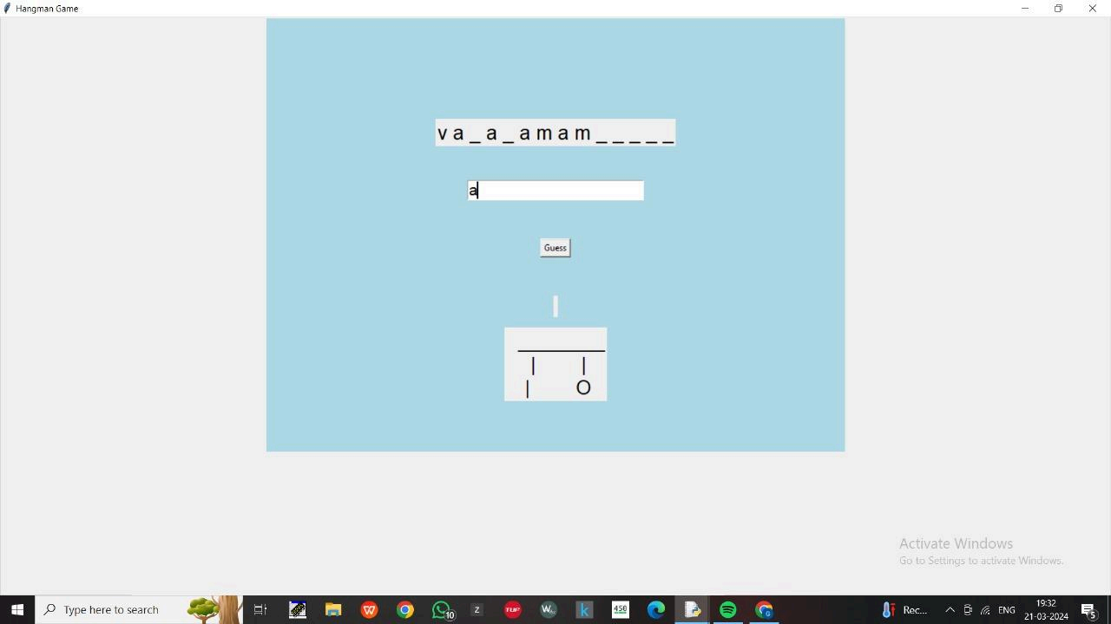

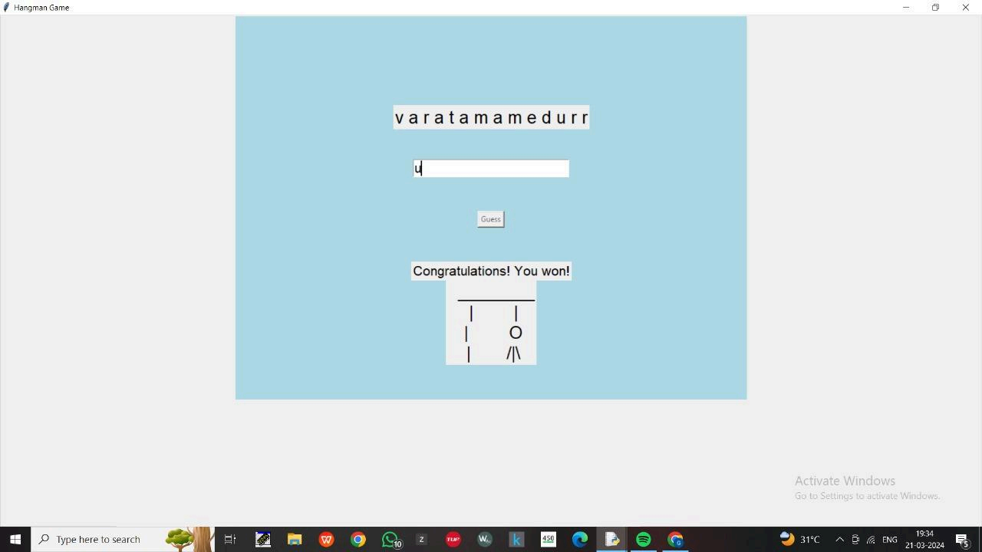

Slide 11

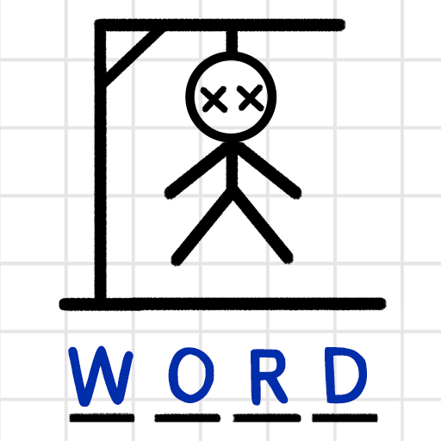
Conclusion and Next Steps
The Hangman game provides a fun and educational experience. The use of Python allows for easy implementation and customization. Future enhancements could include adding features like word categories, difficulty levels, or visual themes.

